Slide 1
Lesson 3: Network hardware
Mack 2023
Notes:
Last updated 30-11-2021
Resources are updated regularly — the latest version is available at: ncce.io/tcc.
This resource is licensed under the Open Government Licence, version 3. For more information on this licence, see ncce.io/ogl.

Slide 2

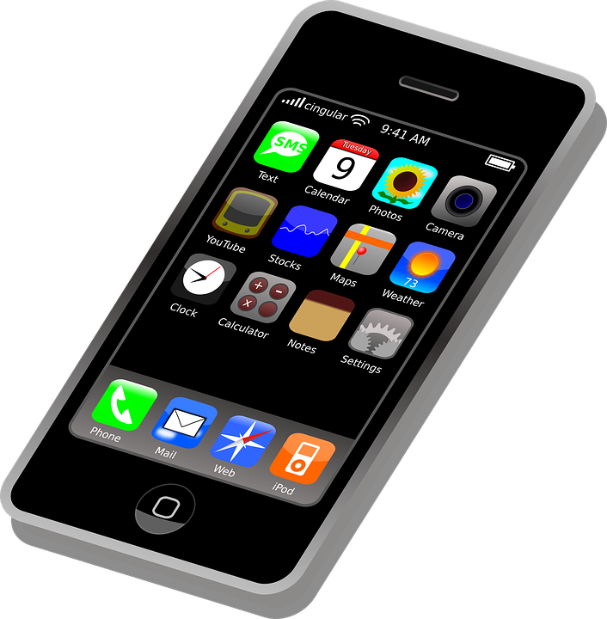

What type of area network?
Starter activity
The images to the right represent a type of area network. Which one does it represent?
Explorer task
Write a description for this type of network.
Notes:
https://www.clipartmax.com/middle/m2i8N4H7m2G6H7Z5_clock-device-smart-smartwatch-time-watch-icon-smart-watch-icon/
https://www.clipartkey.com/view/woRJx_free-to-use-public-domain-mobile-phones-clip/
https://www.clipartmax.com/download/m2i8i8H7A0H7K9i8_laptop-clip-art/

Slide 3

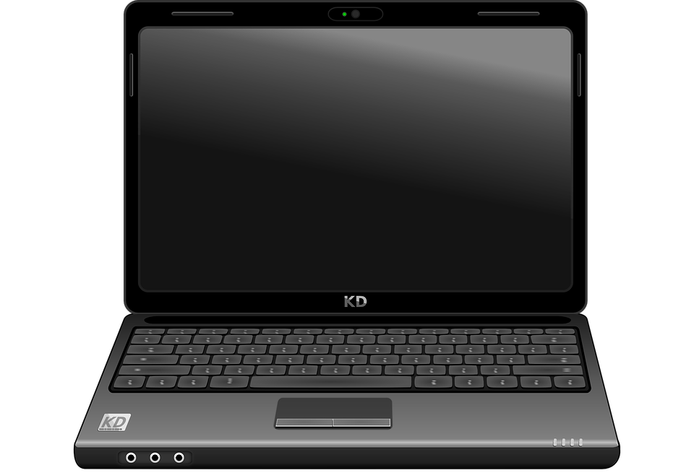
What type of area network?
Starter activity
Answer: Personal Area Network or PAN
Description: A network of computers that connects devices within the locality of a person.

Slide 4

Lesson 3: Network hardware
Objectives
In this lesson, you will:
Describe the tasks performed by the network hardware: wireless access point, router, switch, hub, NIC, and bridge
Define a MAC address

Slide 5
Network hardware
Activity 1
Specialist network hardware is required to allow computers to connect to one another.
Common hardware types are:
Wireless access point
Router
Switch
Hub
Network interface card (NIC)
Bridge

Slide 6
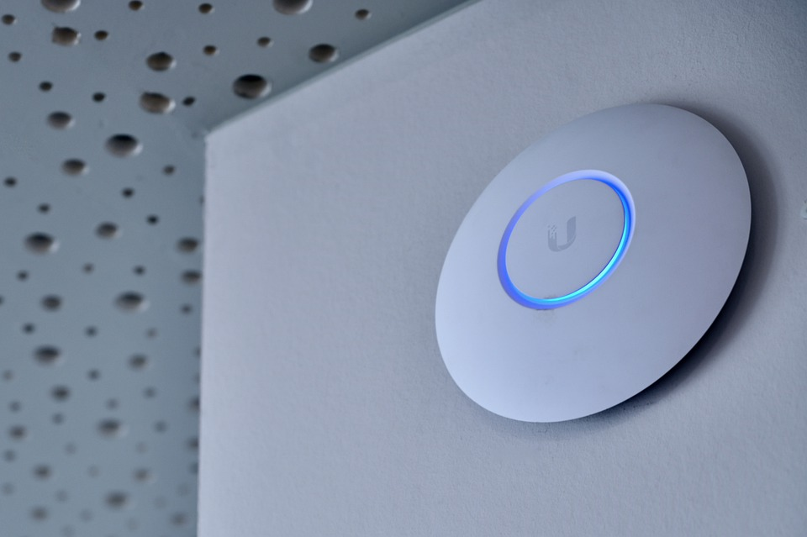

Wireless access point
Activity 1
You may have noticed a wireless access point (WAP) in locations that offer ‘free WiFi’ for you to use.
They are typically found in restaurants, shopping centres, and on public transport.
If you have wireless internet in your home, you will also have a wireless access point. This is often built in to the device provided by your internet supplier.
Notes:
Image source: https://pixabay.com/photos/access-point-internet-wifi-wlan-5002809/

Slide 7
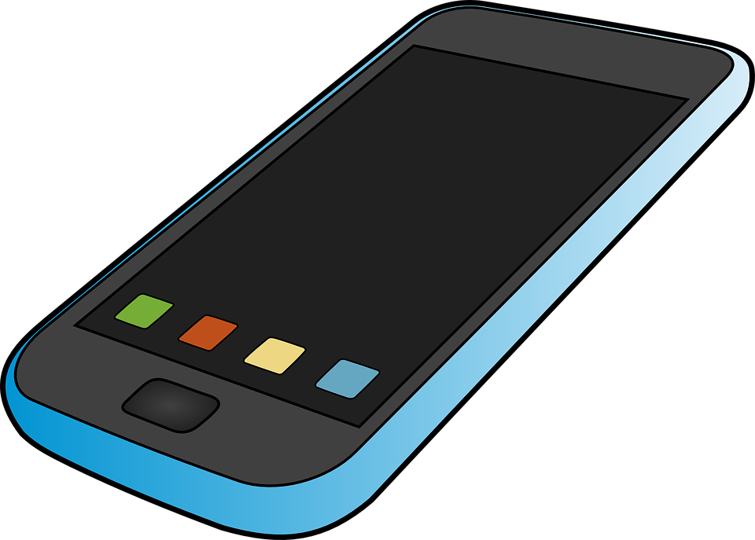
Wireless access point
Activity 1
A wireless access point (WAP) connects to a wired network and provides a wireless network radio signal for wireless devices to connect to.
The WAP provides wireless access to the network. It is not the device that provides internet access, that job is for another device.
Notes:
Image source: https://pixabay.com/vectors/mobile-phone-communication-157065/

Slide 8
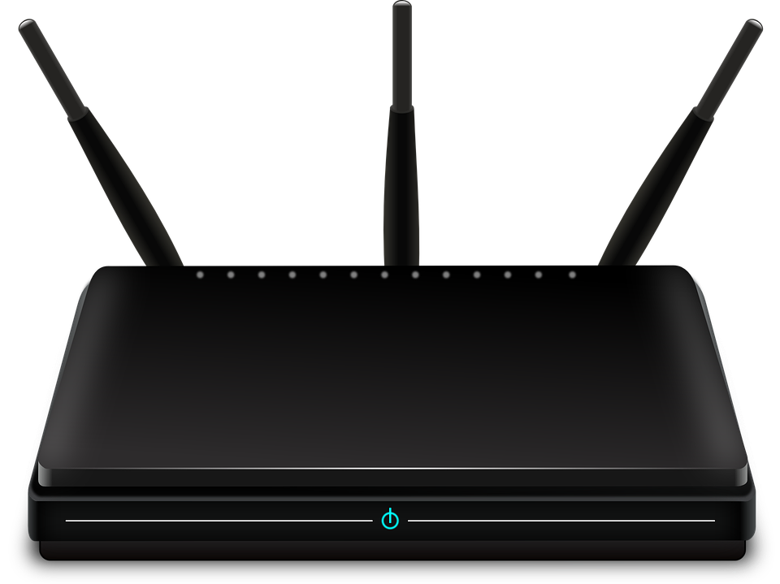

Router
Activity 1
Routers are responsible for moving data from one network to another.
A common use for a router is to connect a network to the internet (which is also a network).
Notes:
Image source: https://pixabay.com/vectors/router-switch-symbol-network-30140/

Slide 9

Router
Activity 1
Internet
To connect wirelessly to the internet, you need a wireless access point and a router.
These are often built into the same device.
Notes:
Image source: https://pixabay.com/vectors/cloud-thought-weather-153992/

Slide 10
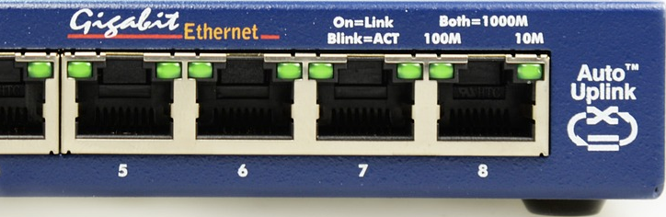

Switch
Activity 1
A switch is required if there are multiple wired connections on the network.
The switch is responsible for connecting data to the correct wired device.
Notes:
Image source: https://pixabay.com/photos/switch-network-it-distributor-nsa-490026/

Slide 11
Switch
Activity 1
A switch is only required if there are wired devices on the network.
A wireless access point will connect data to the correct wireless device.
Notes:
Image source: https://pixabay.com/vectors/router-networking-switch-internet-29336/

Slide 12
Which of these symbols is used for a router?
Activity 1
a)
b)
c)

Slide 13
Which of these symbols is used for a router?
Activity 1
Switch
Router
WAP

Slide 14
Which device is used to connect a network to another network?
Activity 1
Switch
Router
WAP

Slide 15
Which device is used to connect a network to another network?
Activity 1
Switch
Router
WAP

Slide 16
Which device sends data to the correct wired device?
Activity 1
Switch
Router
WAP

Slide 17
Which device sends data to the correct wired device?
Activity 1
Switch
Router
WAP

Slide 18
Which device connects a wireless device to a network?
Activity 1
Switch
Router
WAP

Slide 19
Which device connects a wireless device to a network?
Activity 1
Switch
Router
WAP

Slide 20
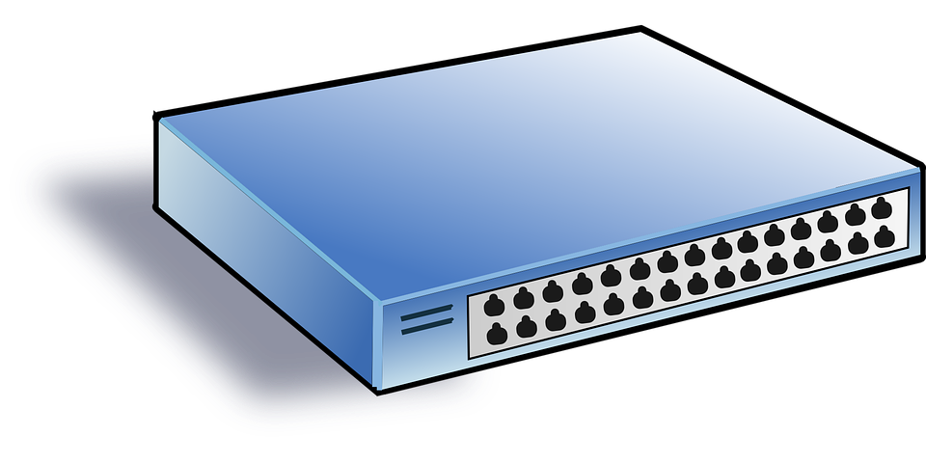

Hub
Activity 1
A hub can be used to connect multiple wired devices together.
A hub will take any incoming data and broadcast (copy and send) it to all other devices connected to the hub.
Notes:
Image source: https://pixabay.com/vectors/switch-hub-network-net-lan-35568/

Slide 21
Hub
Activity 1
Hubs were seen as a cheaper alternative to switches in the early stages of network design.
There are potential security risks with a hub because the data is broadcast to all devices instead of the specific device that needs it.
Switches are much cheaper nowadays and are often used instead of hubs.
Notes:
Image source: https://pixabay.com/vectors/switch-hub-network-net-lan-35568/

Slide 22
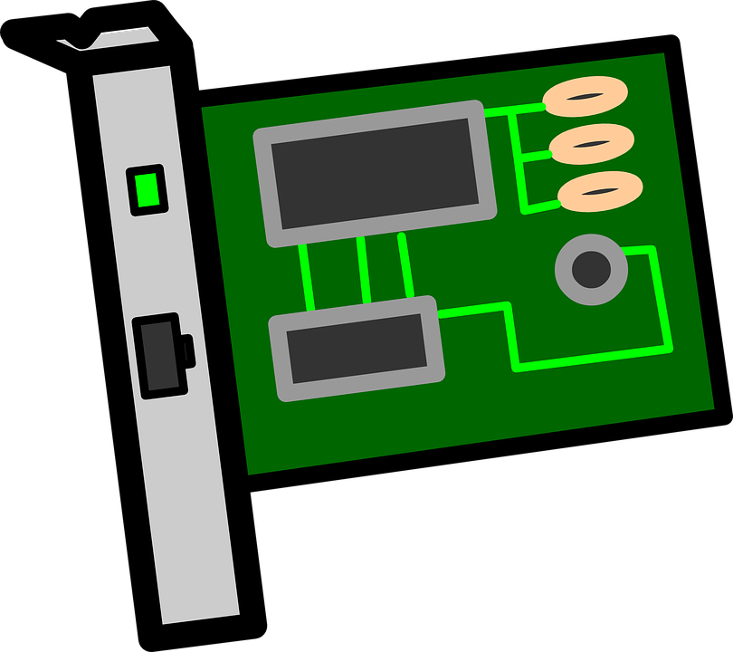
Network interface card (NIC)
Activity 1
A network interface card (NIC) enables a wired network connection between a computer and another networked device.
Notes:
Image source: https://pixabay.com/vectors/card-circuit-electronics-interface-161279/

Slide 23
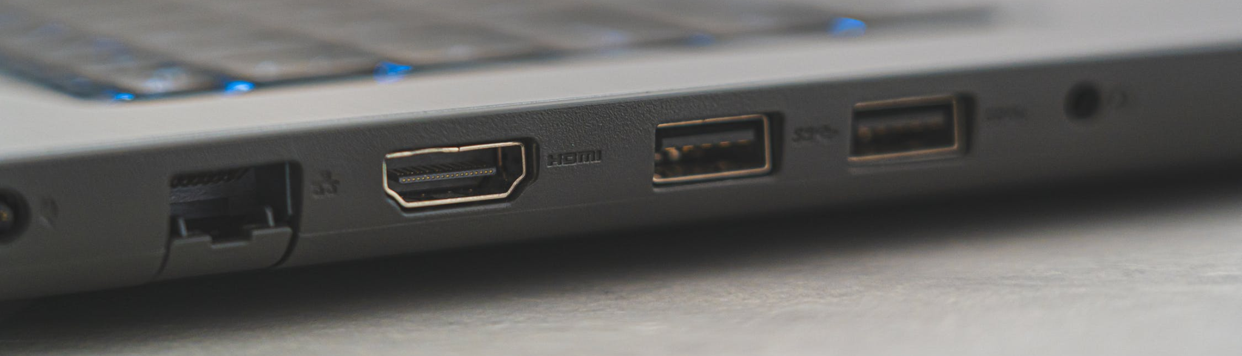
Network interface card (NIC)
Activity 1
You might have noticed a port on a laptop or computer with this symbol.
Inside the computer will be the network interface card and you can connect to it by placing a wire in this port.
Notes:
Image source: https://www.pexels.com/photo/laptop-computer-on-white-table-4065718/

Slide 24
Network interface card (NIC)
Activity 1
Every network interface card has a unique address called a MAC address.
MAC stands for media access control.
This unique, physical address is used to locate devices on the network.
Notes:
Image source: https://pixabay.com/vectors/card-circuit-electronics-interface-161279/

Slide 25
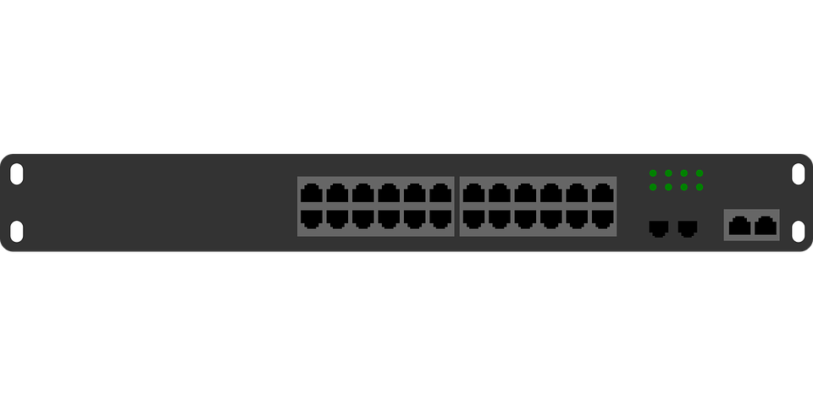

Bridge
Activity 1
A bridge is used to connect a LAN to another LAN.
When a network becomes too large it can cause lots of traffic as data moves through it.
A bridge helps to reduce the traffic by segmenting the network.
Notes:
Image source: https://pixabay.com/vectors/computer-lan-network-switch-158777/

Slide 26
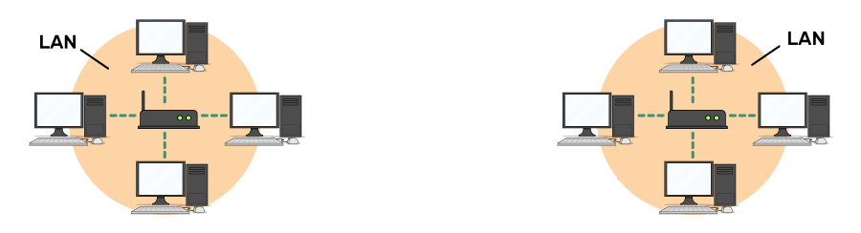
Bridge
Activity 1
Data will only pass through the bridge to the other segment or LAN if it is required by that part of the network.
Notes:
Image source: https://pixabay.com/vectors/computer-lan-network-switch-158777/ and the Raspberry Pi graphic from the Futurelearn course

Slide 27
Which device broadcasts data to all wired devices attached to it?
Activity 1
Hub
NIC
Bridge

Slide 28
Which device broadcasts data to all wired devices attached to it?
Activity 1
Hub

Slide 29
Which device links one LAN to another LAN?
Activity 1
Hub
NIC
Bridge

Slide 30
Which device links one LAN to another LAN?
Activity 1
Bridge

Slide 31
Which device has a unique MAC address to make it identifiable on a network?
Activity 1
Hub
NIC
Bridge

Slide 32
Which device has a unique MAC address to make it identifiable on a network?
Activity 1
NIC

Slide 33
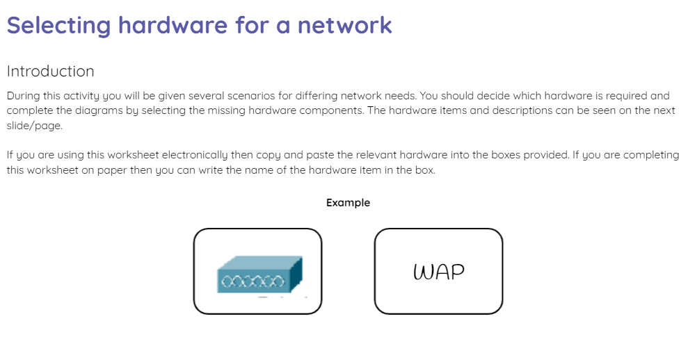
Selecting hardware for a network
Activity 2
Use the activity 2 sheet to decide which hardware items are missing from the networks based on the scenarios.
You will also be required to design your own networks for given scenarios.

Slide 34
What am I?
Plenary
I connect LANs to other LANs on a network. I am also used to segment large LANs to reduce traffic across the network.

Slide 35
What am I?
Plenary
I connect LANs to other LANs on a network. I am also used to segment large LANs to reduce traffic across the network.
Bridge

Slide 36
What am I?
Plenary
I am needed if you want to connect any device to the internet.

Slide 37
What am I?
Plenary
I am needed if you want to connect any device to the internet.
Router

Slide 38
What am I?
Plenary
I am used to securely connect wired devices to each other over a network.

Slide 39
What am I?
Plenary
I am used to securely connect wired devices to each other over a network.
Switch

Slide 40
What am I?
Plenary
If you are going to connect wireless devices to your network then you are going to need me!

Slide 41
What am I?
Plenary
If you are going to connect wireless devices to your network then you are going to need me!
Wireless Access Point
(WAP)

Slide 42
What am I?
Plenary
I must be unique so that I can be identified across a network.

Slide 43
What am I?
Plenary
I must be unique so that I can be identified across a network.
MAC address

Slide 44
Next lesson
Summary
In this lesson, you…
Learnt about the different network components that can be used to create connections within a network
Next lesson, you will…
Learn about network topologies

